Slide 1
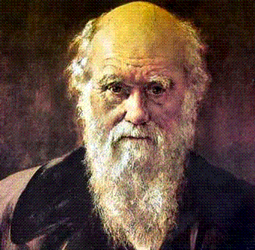

Evolution

Slide 2
Species and Populations
A species is defined as a group of organisms that normally interbreed in nature and share the same gene pool
A population is a group of members of the same species in the same area.

Slide 3
Gene Pool
A gene pool consists of all of the genes in a population at one time.
Each allele has a certain frequency (percentage or fraction) which may change over time.

Slide 4
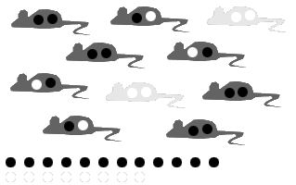
A simplified gene pool
Individuals
Gene pool

Slide 5

Gene frequencies
In the previous example these were the alleles present
Of 20 alleles there are 12 black and 8 white
The gene frequencies are:
0.6 black and 0.4 white
OR 60% black, 40% white

Slide 6
Evolution
Evolution is a change in the gene pool of a population over many generations
While individuals are selected for and against, it is populations that evolve.
Microevolution can result in new varieties
Speciation is the evolution of new species over longer time.

Slide 7
Evidence For Evolution
Main ones:
  Fossil Record
  Comparative anatomy
  Molecular biology
  Biogeography

Slide 8
Fossil Record
Fossil = any trace left by past organisms, e.g. preserved remains, impressions of organisms, footprints.
Fossils:
  Usually in sedimentary rock
  Show organisms appeared in historical sequence
  Today’s complex organisms were preceded by simpler types (e.g. single cells first)
  Transitional forms are found

Slide 9
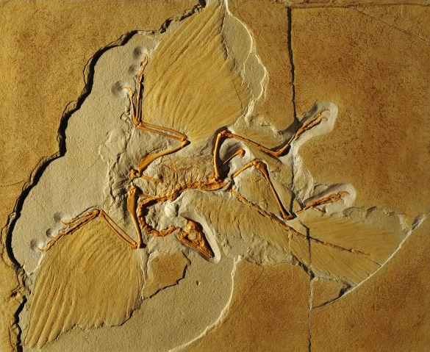
Archaeopteryx – a transitional form between dinosaurs and birds

Slide 10
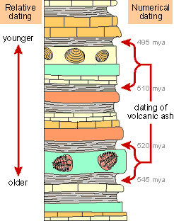
Geological Strata
The deeper the layer the older it is and the more primitive the life forms that existed

Slide 11
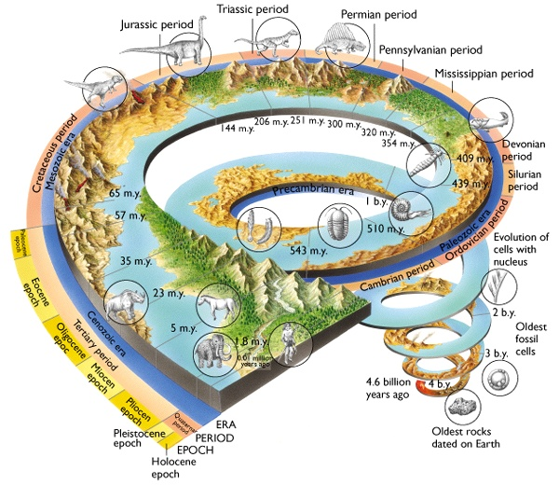

Slide 12
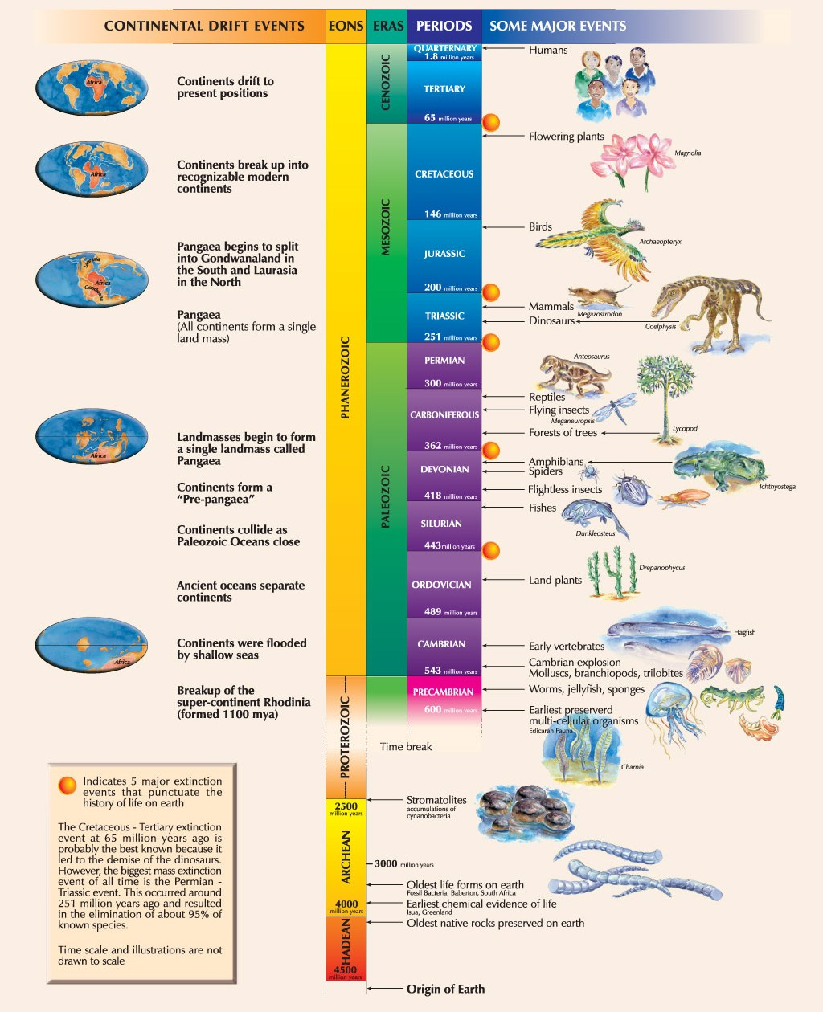
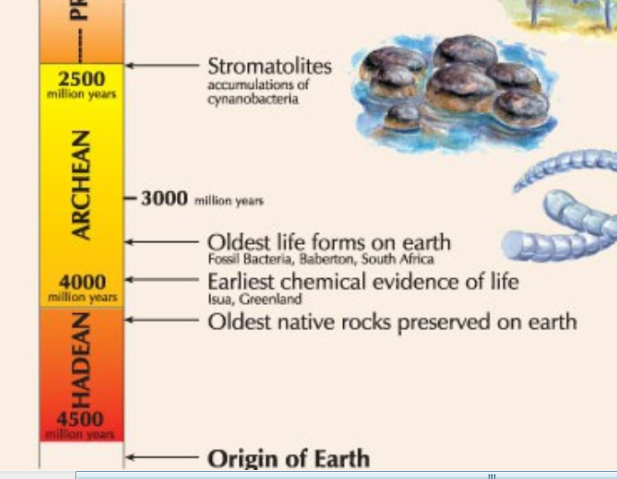
Another view

Slide 13
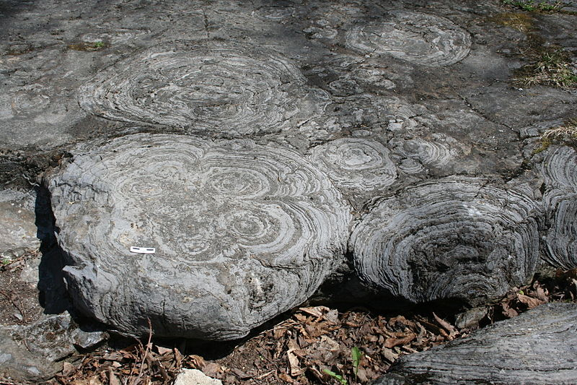

Speaking of Stromatolites
These are 500 million year old stromatolite fossils in the Hoyt Limestone exposed at Lester Park, near Saratoga Springs, New York

Slide 14
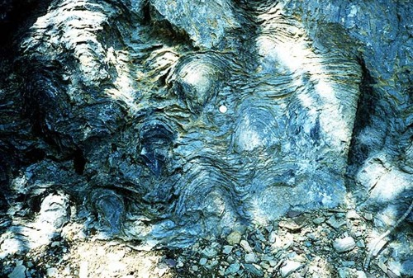
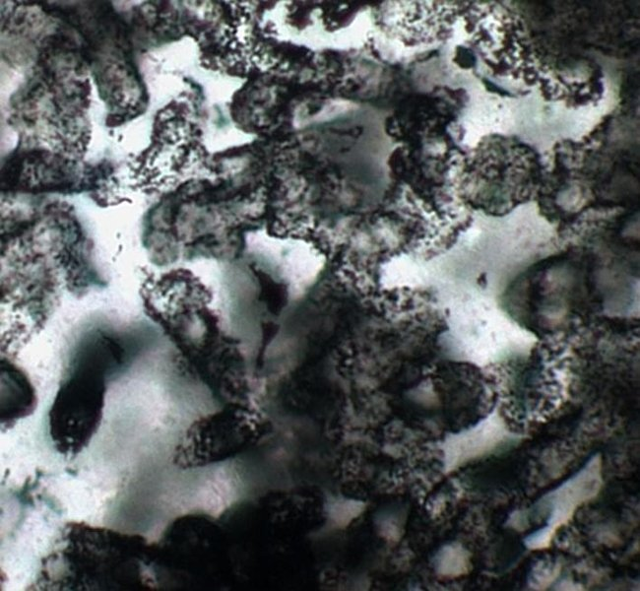
These are 3.5 billion year old stromatolite fossils found in Australia
A collection of tubular microfossils found in 3.4-billion-year-old sandstone from Western Australia

Slide 15
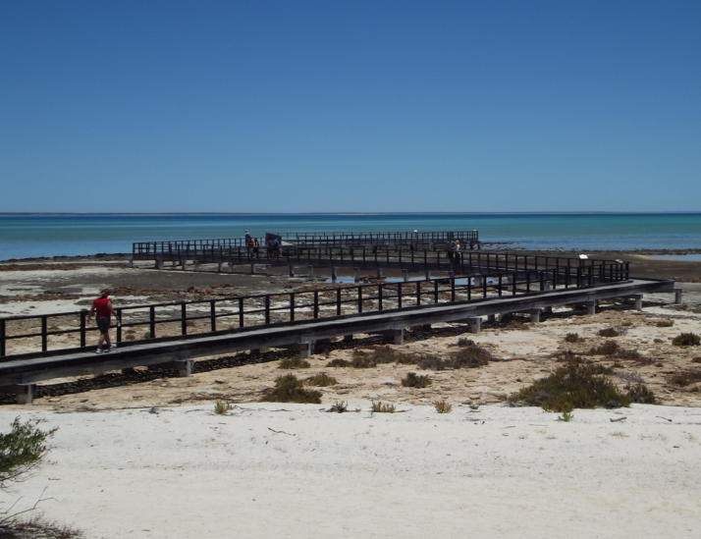
Stromatolites Live! at Hamelin Poole, Shark bay, 800 km north of Perth

Slide 16
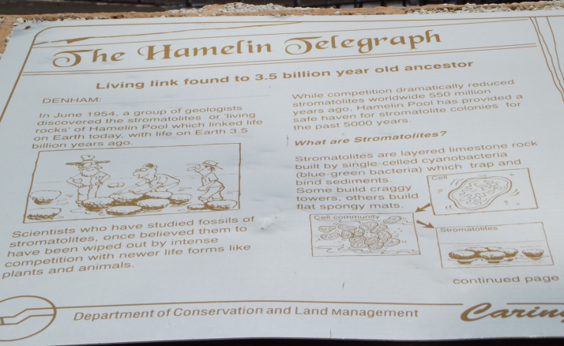

Slide 17
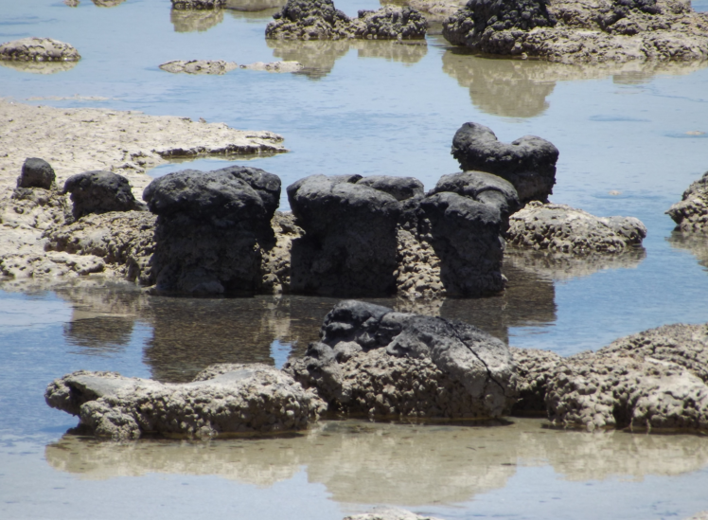

Slide 18
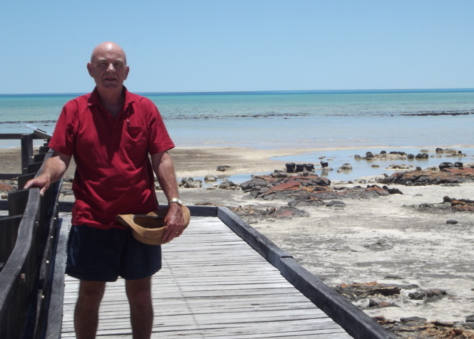

Slide 19
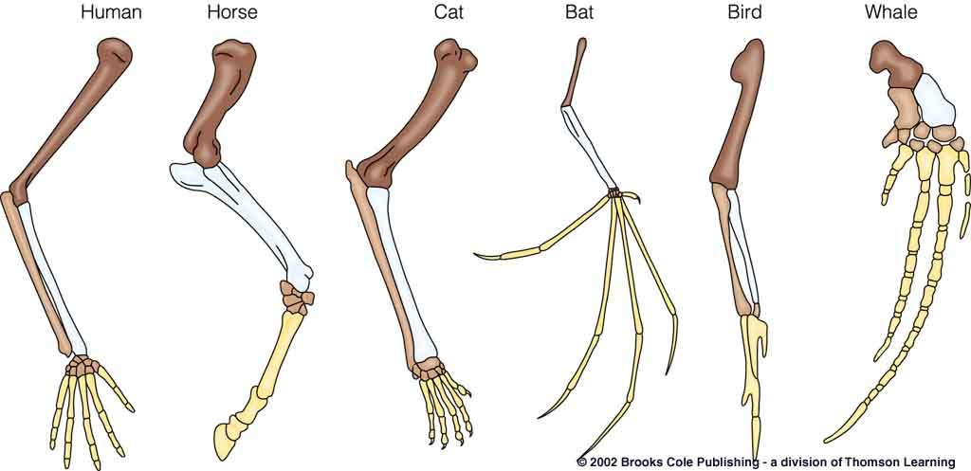
Comparative Anatomy
Comparing structures between species suggests common ancestry
E.g. Homologous structures such as the vertebrate pentadactyl limb

Slide 20
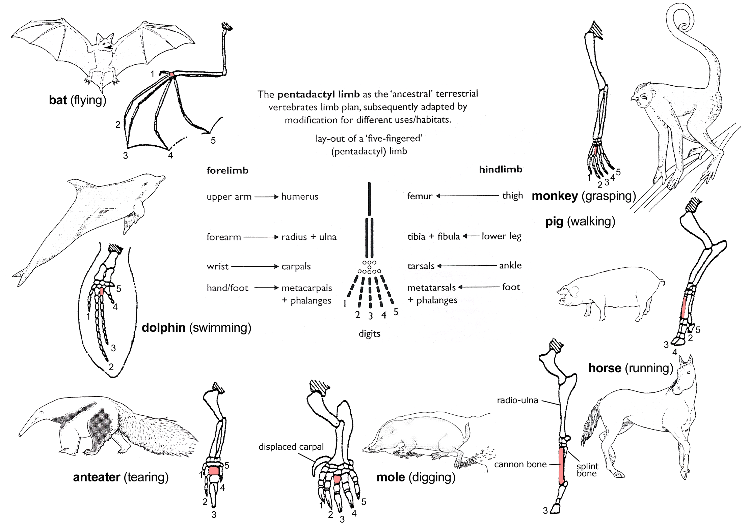

Slide 21
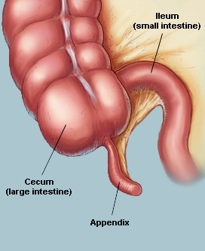
Vestigial Organs
These are organs that have become reduced and lost their function in the course of evolution
Like our appendix

Slide 22
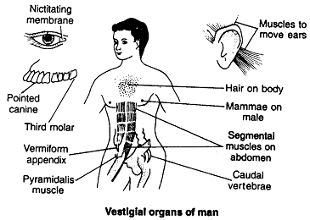
Some human examples

Slide 23
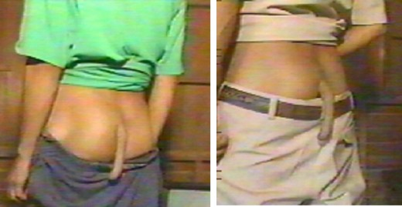
Sometimes they are not so vestigial!
(If you can believe these pictures?)

Slide 24

This one might be a fake?

Slide 25
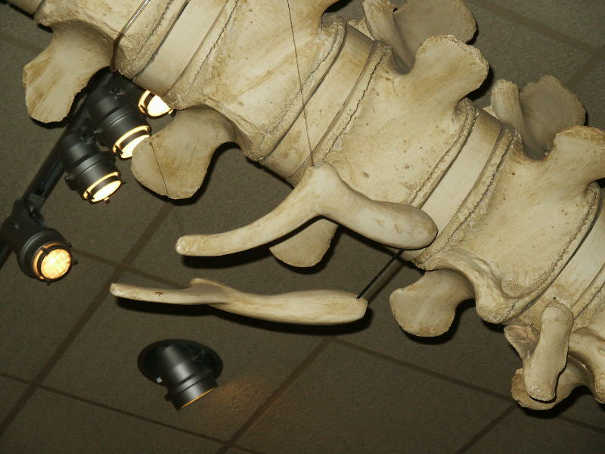
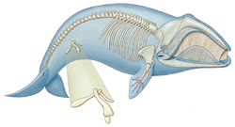
Whale Pelvis

Slide 26
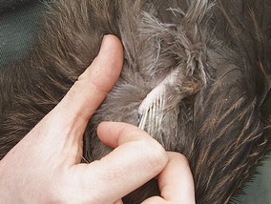
Then there are kiwi wings

Slide 27
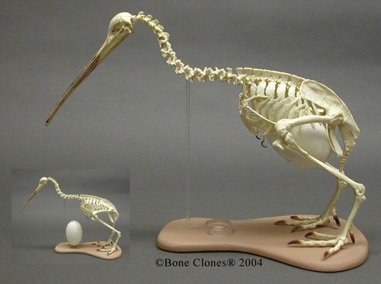

Slide 28
Molecular Biology
All life on Earth shares the same genetic code
The same codons code for the same 20 amino acids in all living things
The more closely two groups are related, the more similar their DNA and proteins

Slide 29
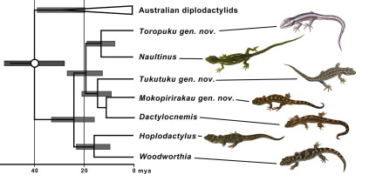
Evolution of N.Z. Geckos based on molecular biology

Slide 30
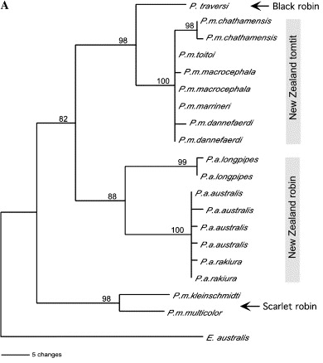
Relationships of New Zealand Petroica species, based on cytochrome b sequences

Slide 31
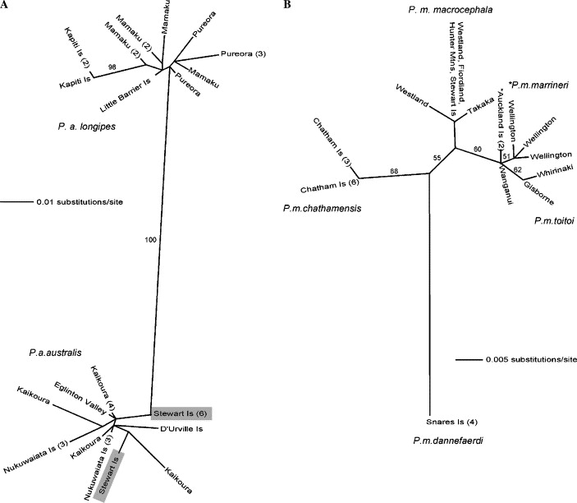

Slide 32
Biogeography
The geographic distribution of species on Earth is consistent with what we know about the movements of tectonic plates and the varying abilities of species to spread out.
Major isolated land areas and island groups often evolved their own distinct plant and animal communities derived from those species that could reach these areas.

Slide 33
“Continental Drift”
Over 200 Million years ago all of the Earth’s landmasses were joined in a supercontinent called Pangea.
This broke into Laurasia in the North and Gondwana in the South.

Slide 34
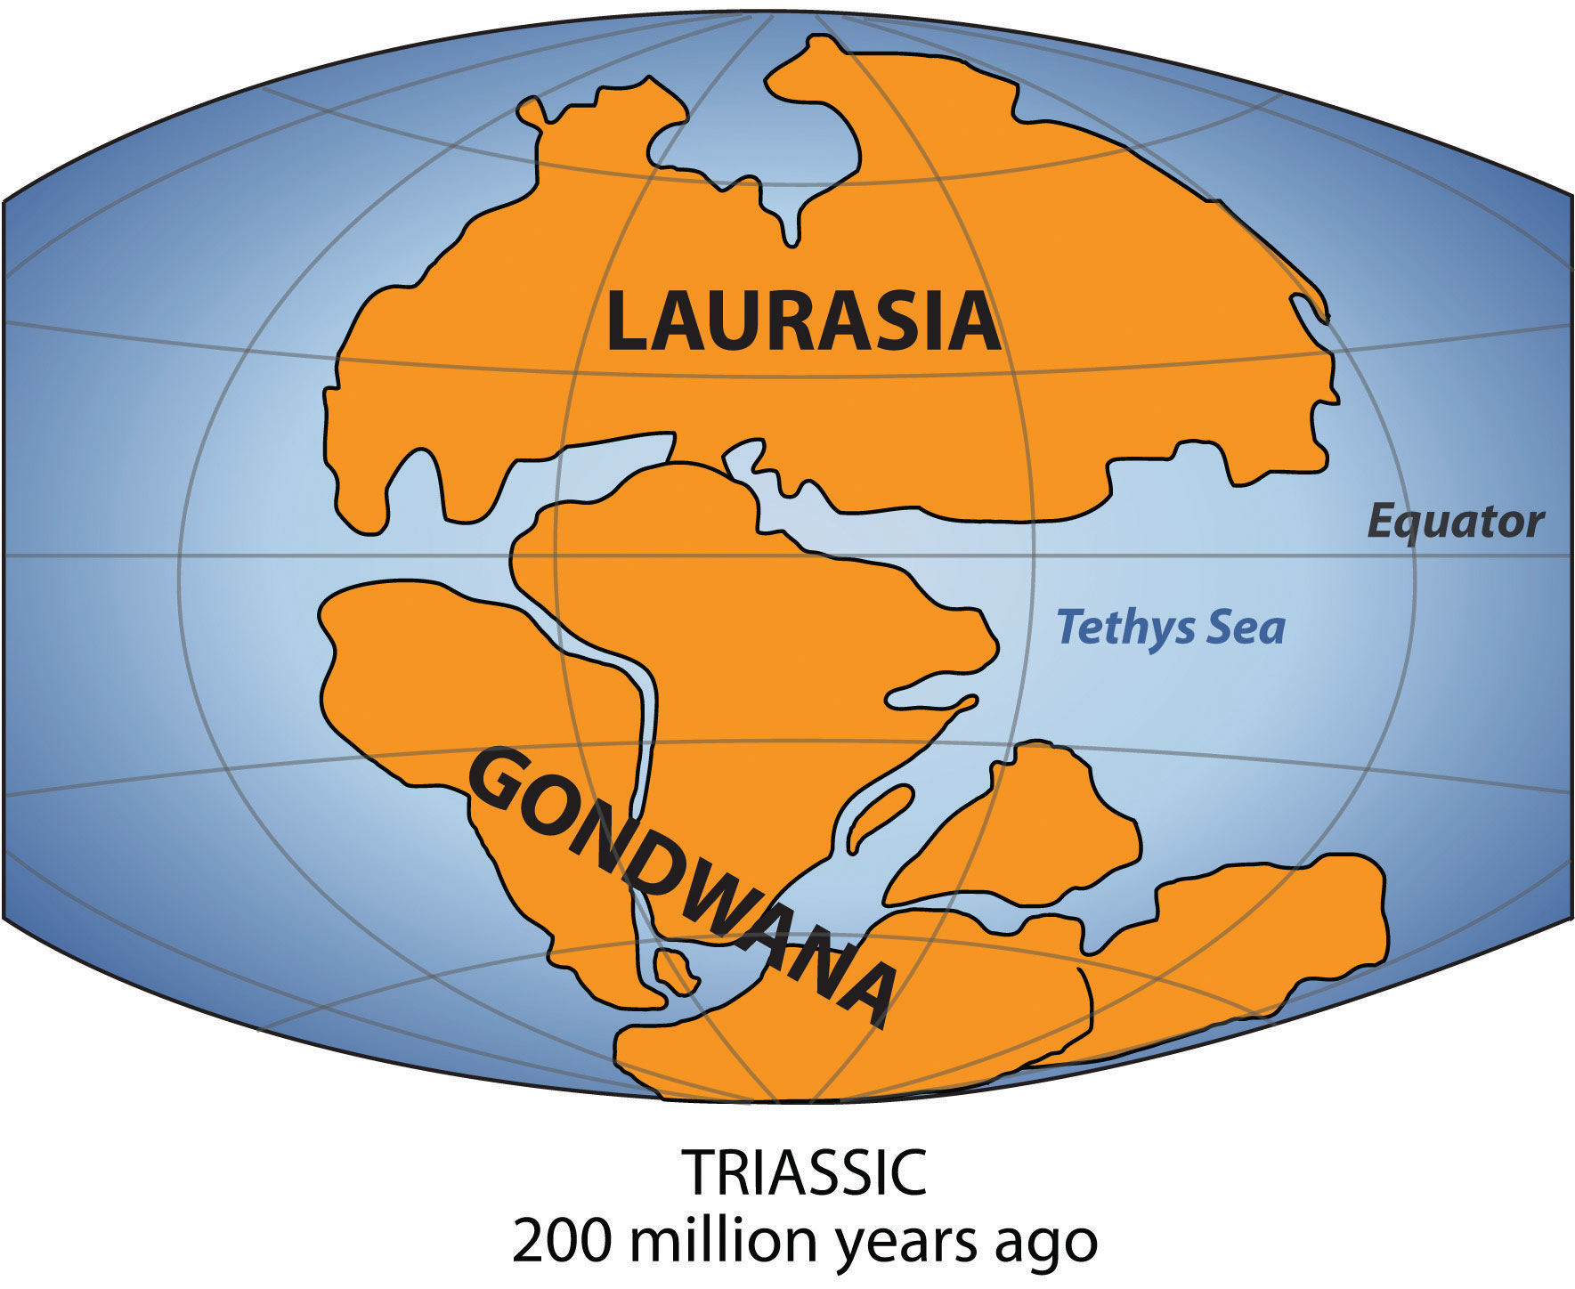
“Continental Drift”

Slide 35
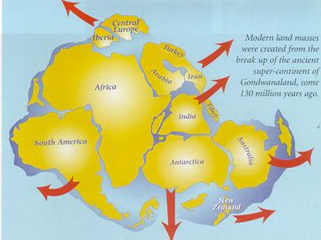
About 130 million years ago Gondwana broke up

Slide 36
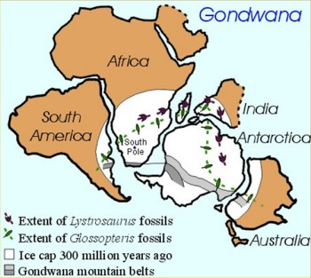
Several species of plant and animal were found on Gondwana and have evolved apart since it split.

Slide 37
An now a little animation
CLICK HERE

Slide 38
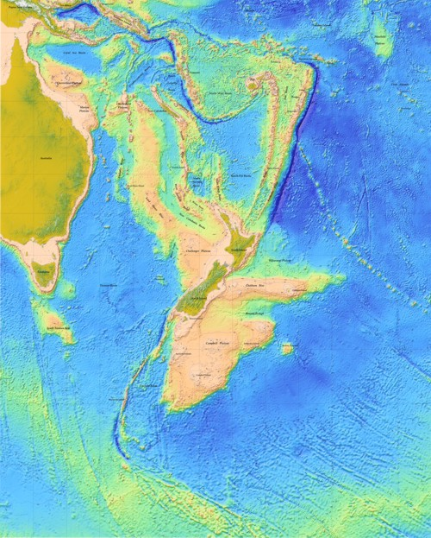
New Zealand separated from Australia about 85 million years ago

Slide 39
Australia split from Gondwana after the appearance of marsupial mammals but before the evolution of placentals. This explains the large number of marsupials such as koalas and kangaroos
N.Z. has no native land mammals or snakes because it split off before they appeared. Our reptile, bird and plant life have evolved from what was here before the split or from those who could get here. The tuatara survived here but died out elsewhere.

Slide 40
  New Zealand Land Mass
New Zealand is part of a largely submerged continent called Zealandia.
This formed off the coast of Gondwana and split off 80 mya.
Over this time there have been many changes to the area, sometimes only a few islands were present.
Volcanoes erupted at times and large areas of sediments formed.

Slide 41
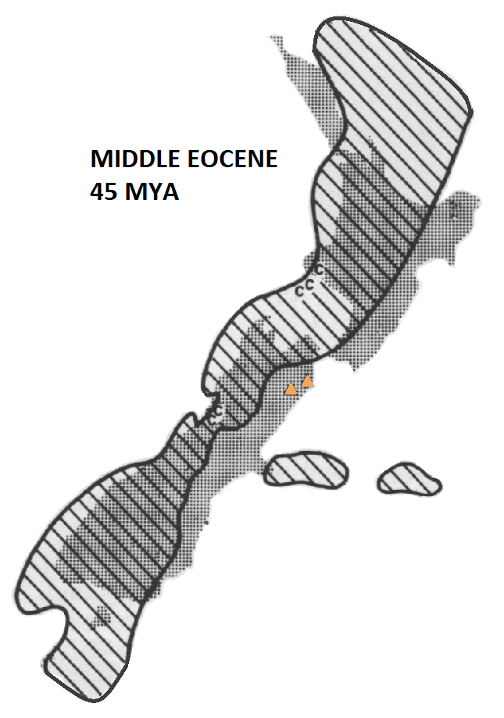
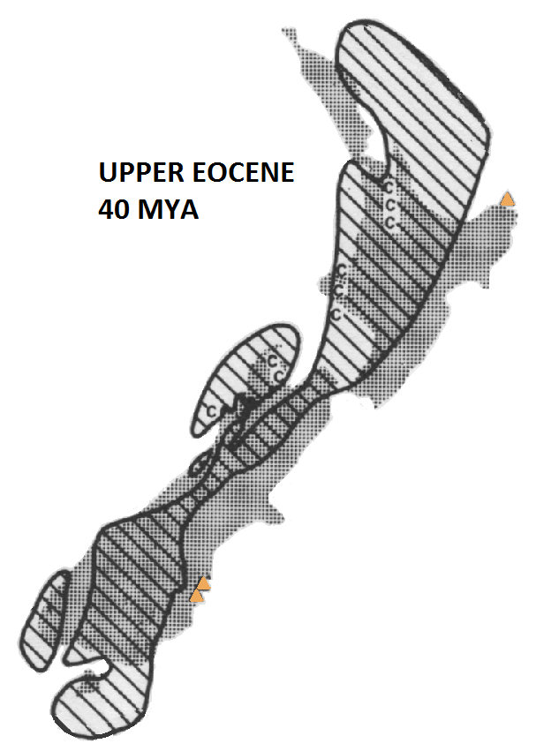
Here are some of the changes

Slide 44
Effects of these changes
The varying amount of land, changes in temperature, volcanism, erosion and mountain-building have affected the evolution of life in N.Z.
Different selection pressures at different times have produced a range of species adapted to the wide range of habitats.
Genetic bottlenecks occurred when sea levels were high.

